Slide 1



INTELLIGENT MANAGEMENT AND CONTROL OF ELECTRICAL LOADS USING A MICROCONTROLLER
Guided By
Dr.P SAKTHI
Presented By
DHARSHINEE S S (927623BEC036)
DURKA SRI N (927623BEC051)
ELAMATHI S (927623BEC053)

Slide 2
INTRODUCTION
Modern electrical systems are becoming increasingly complex due to the growing number of electrical appliances and rising power demand in residential and industrial environments. Conventional protection devices such as fuses and circuit breakers disconnect the entire power supply during overload or fault conditions, leading to unnecessary power interruptions and inconvenience.
These traditional systems lack the ability to selectively identify and isolate faulty loads.
To overcome these limitations, intelligent load management systems using microcontrollers and IoT technologies have emerged as an effective solution.
This project focuses on developing a microcontroller-based system that continuously monitors electrical loads, detects abnormal current conditions, and selectively disconnects only the overloaded load while maintaining uninterrupted power to other loads. The integration of IoT enables real-time monitoring, alerts, and improved energy efficiency.

Slide 3
OBJECTIVE
The system continuously monitors the current drawn by each electrical load in real time to identify overload conditions or abnormal load behavior before it affects the overall electrical system.
When an overloaded or faulty load is detected, the system automatically isolates that specific load using relay-based control, ensuring uninterrupted power supply to other connected loads.
By improving selective load protection and real-time monitoring, the system enhances electrical safety, energy efficiency, and reliable operation while reducing power wastage, equipment damage, and unnecessary system downtime.

Slide 4
SCOPE OF THE PROJECT
This project focuses on designing and implementing an intelligent electrical load management system using a microcontroller to monitor and control multiple electrical loads in real time. The system continuously measures the current drawn by each load and compares it with predefined threshold values to detect overload conditions. Upon detecting an abnormal current, the system selectively disconnects only the affected load while ensuring uninterrupted operation of other loads. The scope includes the integration of current sensors, relay-based load control, microcontroller-driven decision making, and real-time monitoring through a local display. Additionally, the system enables remote monitoring and alert notifications using an IoT module and cloud platform, enhancing safety, reliability, and efficient energy utilization.

Slide 5
LITERATURE REVIEW
S.NO | AUTHOR | TITLE | YEAR | REMARKS
[1] | Yi Zong et al. | Active Load Management in an Intelligent Building Using Model Predictive Control | 2011 | Applies model predictive control techniques for optimized load scheduling in intelligent buildings, improving energy efficiency and power distribution.
[2] | F. D’Agostino et al. | Smart Management of Demand in Naval Applications | 2015 | Discusses distributed and decentralized load control strategies for naval power systems to reduce disturbances caused by variable load conditions.
[3] | R. S. Vignesh et al. | GSM Based Electrical Load Control System for Home Applications | 2022 | Introduces a GSM-based system for remote load control in home applications, enabling flexible switching of electrical loads through wireless communication.
[4] | R. Islam et al. | Design and Development of a Smart Billing Meter for Load Management and Tampering Alerts | 2024 | Presents a smart billing meter with tamper detection and load monitoring, emphasizing secure energy usage data and alert mechanisms to enhance load management efficiency.
[5] | D. C. Teja et al. | IoT-Enabled Smart Home Management System Featuring Fault Detection and Remote Monitoring | 2025 | Proposes an IoT-based smart home system capable of real-time fault detection and remote monitoring, highlighting the importance of continuous load supervision for improving system reliability and user awareness.

Slide 6
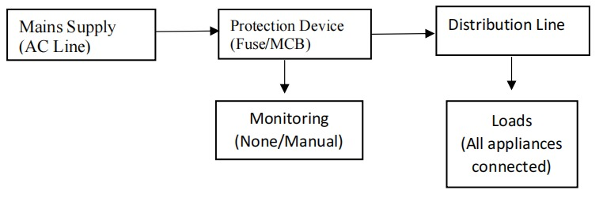
EXISTING SYSTEM
Fault Detection Method: Based on conventional protection devices such as fuses and MCBs, which respond only to excessive current or short-circuit conditions without intelligent analysis.
Fault Isolation Type: Full supply shutdown, where the entire electrical line is disconnected during fault or overload conditions.
Power Continuity: Completely interrupted for all connected loads when a fault occurs.
Accuracy of Fault Detection: Low to moderate, as faults are detected only after reaching critical current levels.
Safety and Reliability: Moderate, providing basic protection but lacking selective control and real-time monitoring.
Maintenance Approach: Reactive maintenance, where action is taken only after a fault or failure occurs.
EXISTING SYSTEM

Slide 7
PROBLEM STATEMENT
Conventional electrical protection systems such as fuses and MCBs disconnect the entire power supply during overload or fault conditions, resulting in unnecessary power interruptions and inconvenience to users. These systems lack real-time monitoring, selective fault isolation, and intelligent decision-making capabilities. As a result, even a single faulty load can cause complete system shutdown, reduced reliability, delayed fault detection, and inefficient energy utilization. There is a need for an intelligent load management system that can continuously monitor electrical loads, accurately detect abnormal conditions, selectively isolate only the faulty load, and ensure uninterrupted power supply to critical loads while improving safety and energy efficiency.

Slide 8
PROPOSED SYSTEM
Fault Detection Method: Based on real-time current monitoring using current sensors and microcontroller-based threshold analysis.
Fault Isolation Type: Only the faulty or overloaded electrical load is selectively isolated using relay-based control.
Power Continuity: Seamless and uninterrupted for all healthy and critical loads.
Accuracy of Fault Detection: High, as abnormal current conditions are detected at an early stage.
Safety and Reliability: Highly improved due to selective tripping and intelligent monitoring.
Maintenance Approach: Predictive and preventive, enabled through continuous monitoring and early fault identification.

Slide 9
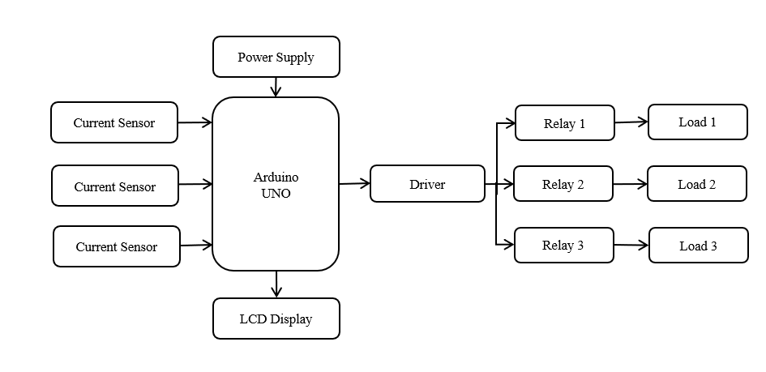
BLOCK DIAGRAM

Slide 10
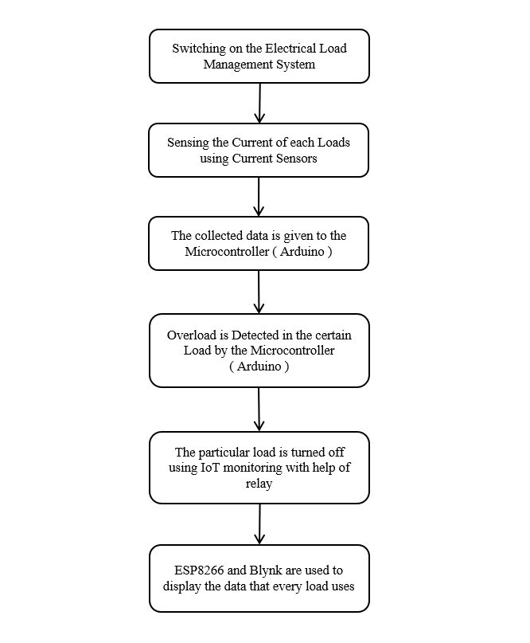
FLOWCHART

Slide 11
HARDWARE USED
Microcontroller (Arduino UNO) – Acts as the main control unit to monitor real-time current values from each load, process sensor data, compare it with preset threshold limits, and control relay switching operations.
Current Sensor (ACS712) – Measures the current drawn by each electrical load continuously and provides analog signals to the microcontroller for overload detection.
Relay Module – Used to selectively isolate overloaded or faulty electrical loads by switching the supply ON or OFF under microcontroller control.
ESP8266 Wi-Fi Module – Enables IoT-based remote monitoring by transmitting load parameters, system status, and overload alerts to the cloud platform.
Power Supply Unit (Step-Down Transformer, Rectifier & Regulator) – Converts AC mains voltage (230V) to a regulated DC voltage suitable for powering the microcontroller, sensors, and relay circuit.
LCD Display (16×2) – Displays real-time current values and ON/OFF status of each electrical load for local monitoring.

Slide 12
SOFTWARE USED
Blynk IoT Platform – The Blynk mobile application is used to create a real-time dashboard for monitoring current values, load status, and receiving overload alert notifications remotely.

Slide 13
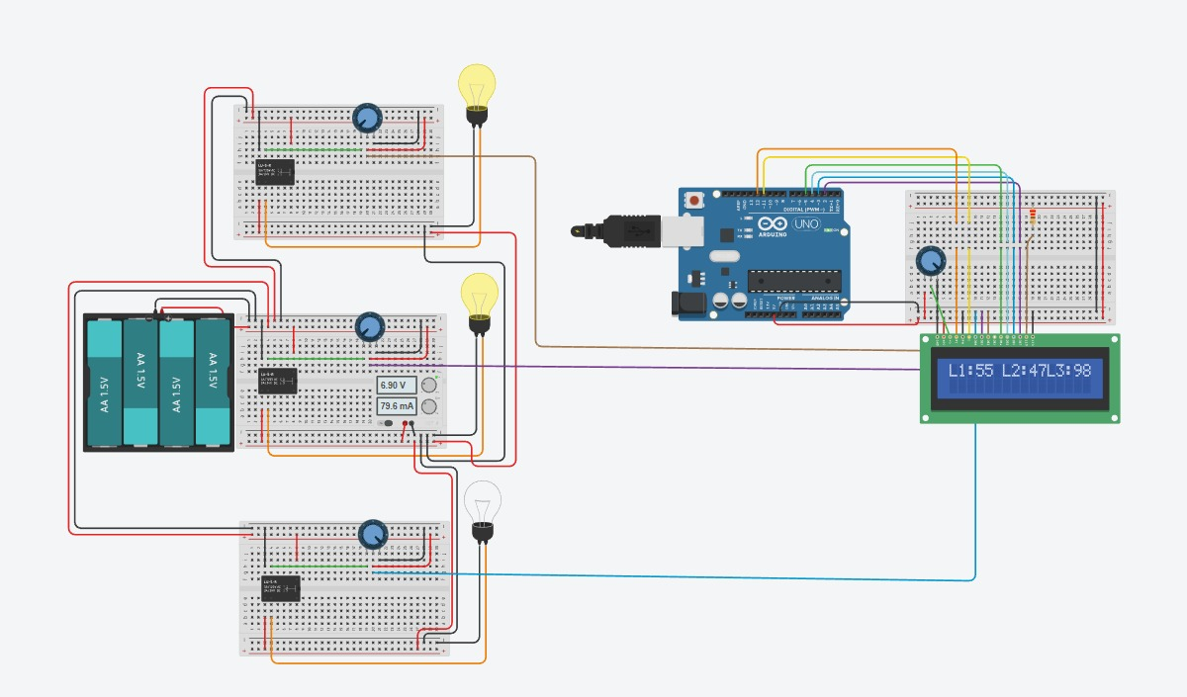
SIMULATION RESULTS

Slide 14
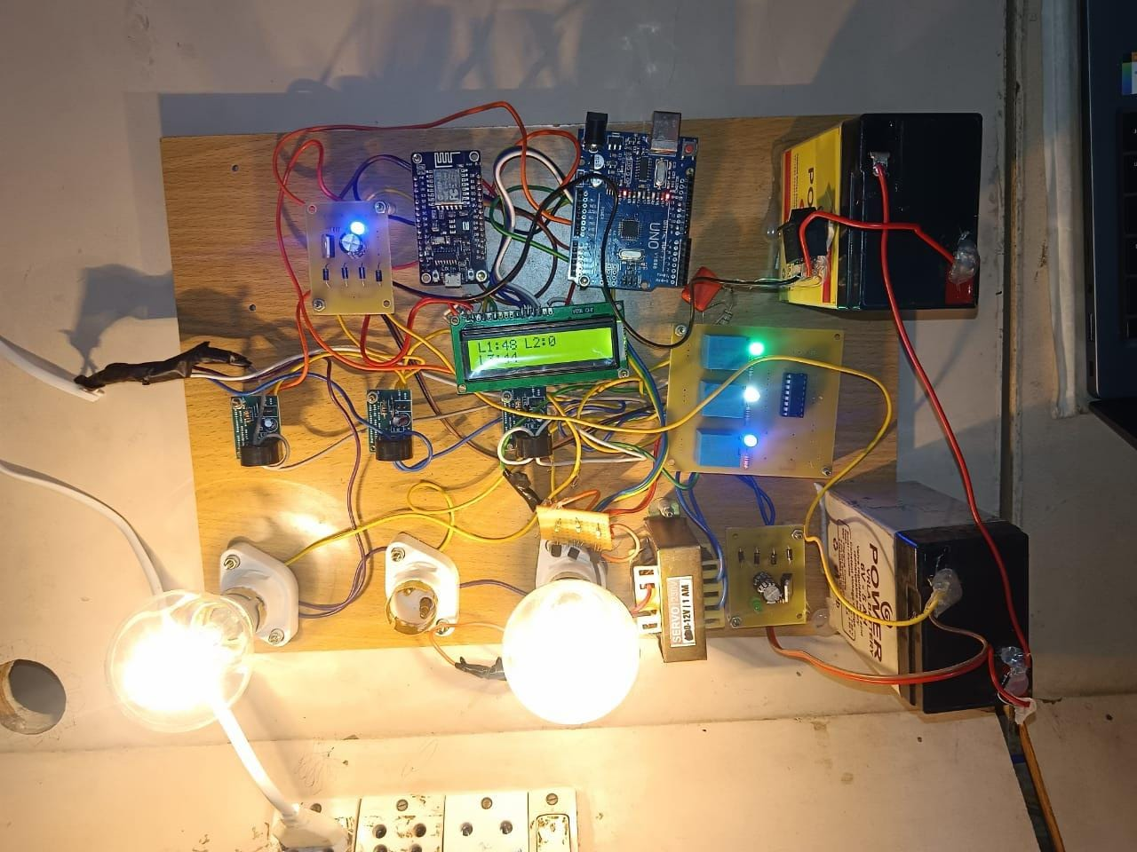
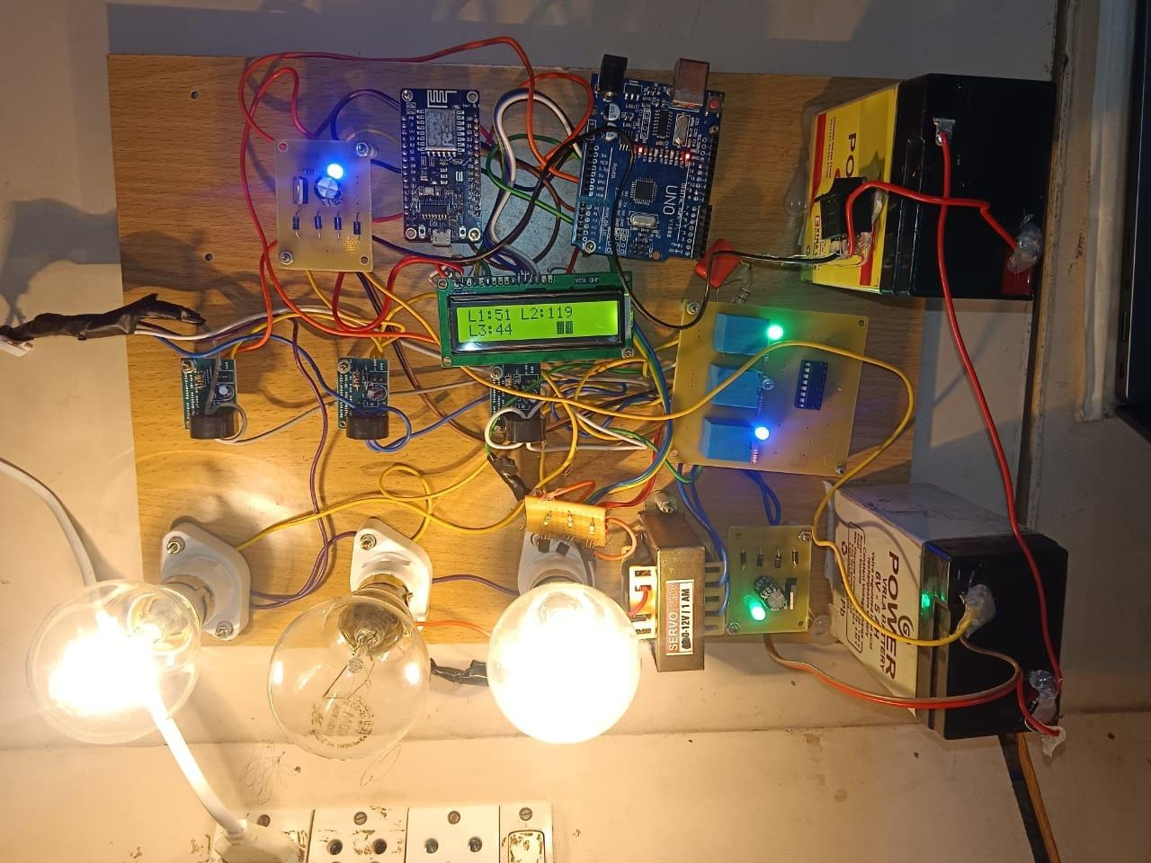
HARDWARE PROTOTYPE
The hardware platform in normal operating condition when all loads are active
An overload-condition and selective tripping condition when Load 2 is turned off as it is overloaded

Slide 15
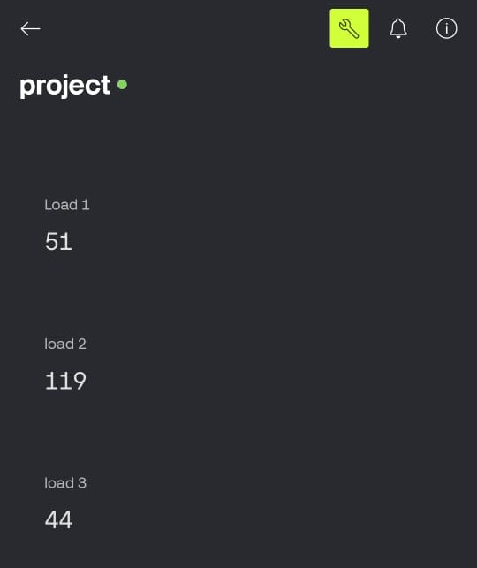
RESULTS
Result for intelligent management and control of electrical loads using a microcontroller Blynk

Slide 16
DISCUSSION
The implemented intelligent load management system was tested under both normal and overload operating conditions to evaluate its performance and reliability. During normal operation, all electrical loads functioned within the predefined current limits, and the system continuously displayed real-time current values and load status on the LCD and IoT dashboard. When an overload condition was intentionally introduced to a specific load, the system successfully detected the abnormal rise in current using the current sensor and microcontroller-based threshold analysis. The affected load was selectively disconnected through the relay module, while other loads continued to operate without interruption.The integration of IoT enabled real-time remote monitoring and alert notifications, improving user awareness and enabling faster response to fault conditions. Overall, the results demonstrate improved safety, faster fault detection, higher energy efficiency, and reliable operation, validating the effectiveness of the proposed intelligent load management system.

Slide 17
APPLICATIONS
Smart home electrical load monitoring and control
Commercial buildings and office power management
Small-scale industrial load protection systems
Laboratories and educational institutions
Energy-efficient electrical distribution systems

Slide 18
ADVANTAGES
Selective isolation of faulty loads without shutting down the entire system
Real-time monitoring and faster fault detection
Reduced power wastage and improved energy efficiency
IoT-based remote monitoring and alert notifications
LIMITATIONS
Depends on stable internet connectivity for IoT features
Limited to predefined current threshold settings
Suitable mainly for low- and medium-power applications

Slide 19

PROJECT OUTCOME

Slide 20


Slide 21
FUTURE SCOPE
The future scope of this project includes enhancing the system with predictive fault detection techniques using advanced data analytics or machine learning to identify potential failures at an early stage. The system can be extended to support higher power ratings and three-phase electrical systems for industrial applications. Cloud-based data storage and analysis can be implemented to study long-term energy consumption patterns and optimize load usage. Integration with smart meters and smart grid infrastructure will further improve energy management capabilities. Additionally, developing a dedicated web or mobile application can provide advanced monitoring, control, and user interaction features.

Slide 22
CONCLUSION
The intelligent management and control of electrical loads using a microcontroller provides an effective solution to the limitations of conventional protection systems. By continuously monitoring current values and selectively isolating only the faulty load, the system ensures uninterrupted power supply to healthy loads while improving electrical safety and reliability. The integration of IoT enables real-time monitoring and alert notifications, enhancing user awareness and control. Experimental results demonstrate improved response time, reduced power interruptions, and better energy efficiency. Overall, the proposed system is cost-effective, scalable, and well suited for residential, commercial, and small-scale industrial applications.

Slide 23
REFERENCES
D. C. Teja, M. B. N. Rao and G. D, "IoT-Enabled Smart Home Management System Featuring Fault Detection and Remote Monitoring," 2025 International Conference on Computing and Communication Technologies (ICCCT), Chennai, India, 2025, pp. 1-6, doi: 10.1109/ICCCT63501.2025.11019690.
R. Islam, N. Tabassum, T. Islam, M. Hassan, N. Goswami and A. H. Shatil, "Design and Development of a Smart Billing Meter for Load Management and Tampering Alerts," 2024 IEEE International Conference on Power, Electrical, Electronics and Industrial Applications Bangladesh, 2024, (PEEIACON), Rajshahi, pp. 479-483, doi: 10.1109/PEEIACON63629.2024.10800486.
T. R. Ayodele, A. S. O. Ogunjuyigbe, C. L. Enwere, T. C. Mosetlhe and A. A. Yusuff, "Development of A User-Enabled Load Manager for Electrical Appliances," 2022 IEEE PES/IAS PowerAfrica, Kigali, Rwanda, 2022, pp. 1-5, doi: 10.1109/PowerAfrica53997.2022.9905403.
R. S. Vignesh, P. Vinayagam, S. Gomathi, S. J. Rubavathy, Indumathi and T. Muthamizhan, "GSM Based Electrical Load Control System for Home Applications," 2022 International Conference on Computer, Power and Communications (ICCPC), Chennai, India, 2022, pp. 10.1109/ICCPC55978.2022.10072210. 640-645

